Slide 1
PROJECT TITLE
REAP BIG IN THE SKY!
DIVE INTO FILMS AND MOVIES!!!!

Slide 2
OVERVIEW/OUTLINE OF THE PROJECT
In this project I seek to solve a business stakeholder problem who has been in aviation business but wants to expand it.
The main task is to help the head of aviation department on choice of aircraft to buy.
The aircraft should be safe and less risky to the company as well as well as its customers.

Slide 3
BUSINESS UNDERSTANDING
The company now sees all the big companies creating original video content and they want to get in on the fun. They have decided to create a new movie studio, but they don’t know anything about creating movies. You are charged with exploring what types of films are currently doing the best at the box office. You must then translate those findings into actionable insights that the head of your company's new movie studio can use to help decide what type of films to create.

Slide 4
DATA UNDERSTANDING
Here will need to understand our data. This involves getting the relevant information from each dataset crucial for our analysis.
We start by loading the various datasets reviewing their various information based on the columns and check which information is necessary for our analysis before beginning the data cleaning.
. Movie Performance Data
Box Office Data: Includes revenue by day, week, or year for individual movies. Useful for analyzing trends in revenue over time.

Slide 5
DATA UNDERSTANDING Cont……1.
Weekend Box Office Data: Aggregated weekend earnings, helpful for identifying peaks in movie viewership.
Cumulative Box Office: Total earnings over time for each movie.
2. Movie Metadata
Movie Titles and Release Dates: Basic information about movies, such as title, genre, release date, and distributor.
Genre and Ratings: Helps in analyzing how genres or ratings affect performance
3. Home Entertainment Data
DVD/Blu-ray Sales: Useful for understanding post-theater revenue streams.
Digital Sales/Streaming Revenue: Can show trends in digital distribution.
4. Market-Level Data
Market Share by Studio: Helps analyze how different studios perform over time.
International Box Office: Useful for cross-region comparison and global trends.

Slide 6
DATA UNDERSTANDING CONT…….2
3. Home Entertainment Data
DVD/Blu-ray Sales: Useful for understanding post-theater revenue streams.
Digital Sales/Streaming Revenue: Can show trends in digital distribution.
4. Market-Level Data
Market Share by Studio: Helps analyze how different studios perform over time.
International Box Office: Useful for cross-region comparison and global trends.

Slide 7
OBJECTIVES/GOALS
To analyze movie data and uncover key patterns in revenue, popularity, ratings, and director influence across genres, providing actionable insights for business growth and strategic decision-making.

Slide 8
METHODOLOGY
The data cleaning was done after extracting the data from the different sources .the first step was checking through the columns to se whether there are are outliers in the data.the uniformity of the data checkedt.some values were not making sense in the the data .this prompted for dropping them, for security reasons.
Checking unique values,null values and logical consistency.
Dropping irrelevant columns;id.
Checking data uniformity.
Imputing using the median and Q3.
Checking categorical columns.
Checking duplicates.(none).
Checking for outliers.
Convert names in ‘make’ to lower case
Saving the clean data.
Hypothesis testing and modeling.
Connect clean data to tableau.
Data visualization,drawing insights and recommendatios.
Conclusion

Slide 9
DATA CLEANING REPORT
The data cleaning involved: renaming of columns ,checking duplicates ,removing outliers , feature engineering and saving the datasets for re-use.

Slide 10
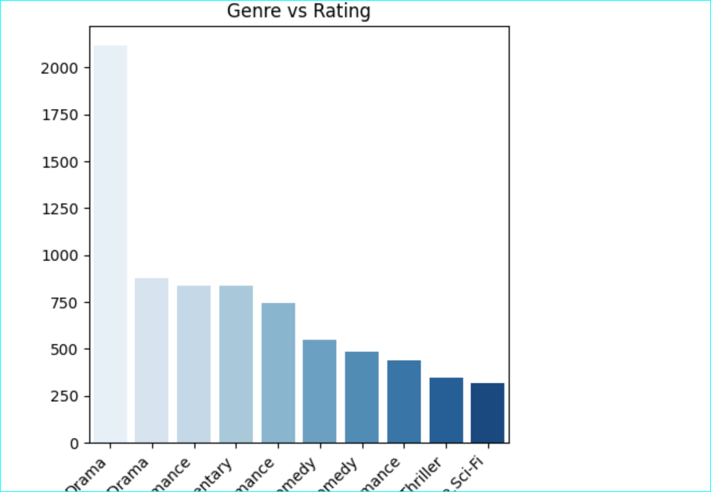
visual
Notes:
fig1:The highly rated genre is drama.

Slide 11
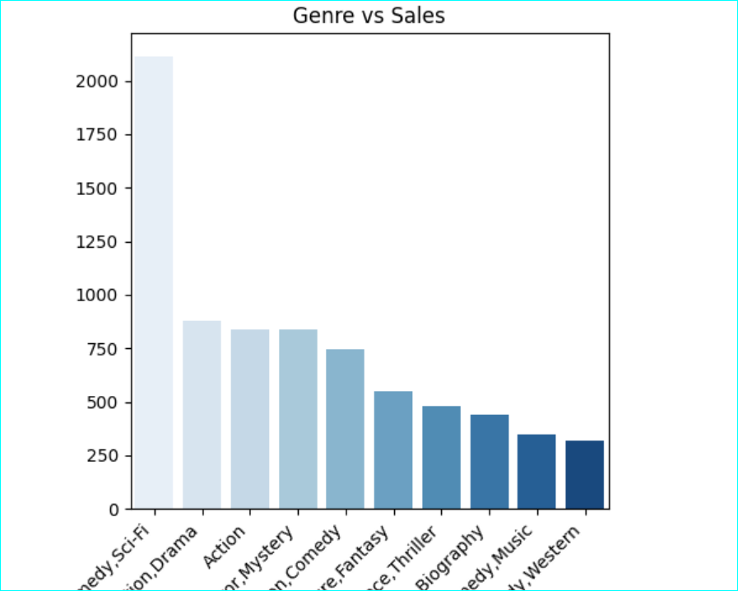
VISUAL
Notes:
Fig 2:Highest sales were from comedy,followed by drama.

Slide 12
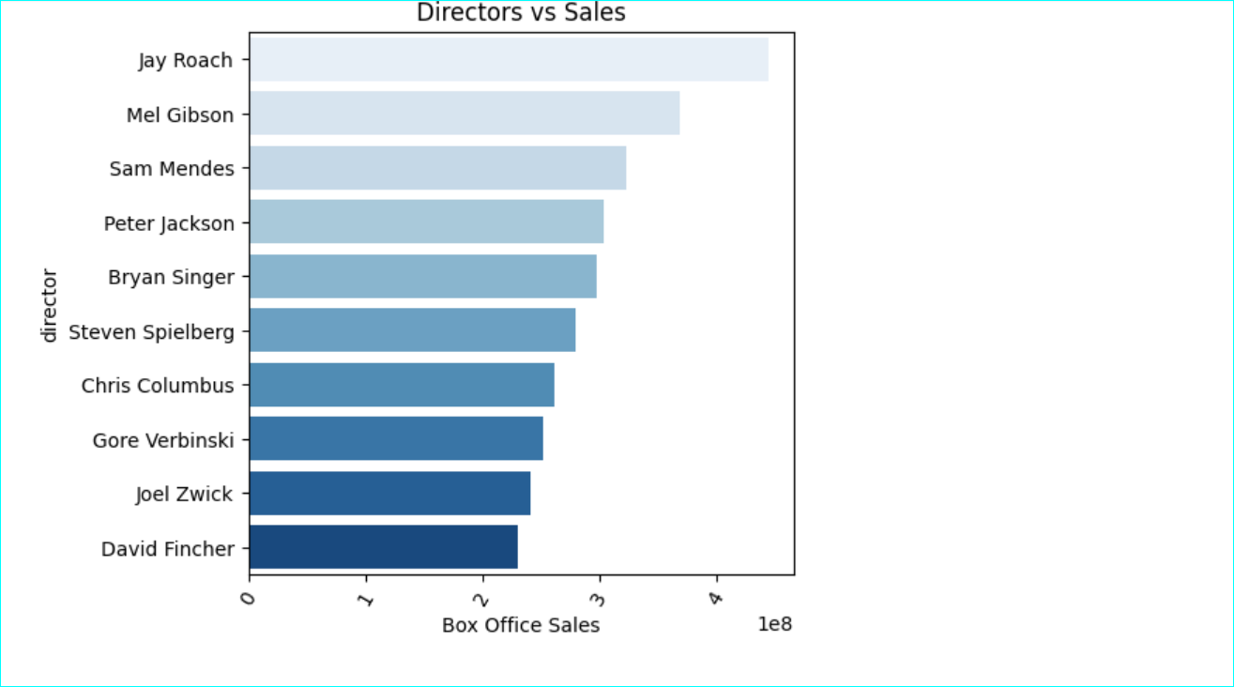
VISUAL
Notes:
Fig 3:movies and films from Jay roach made highest sales followed by Mel Gibson and Sam Mendes.

Slide 13
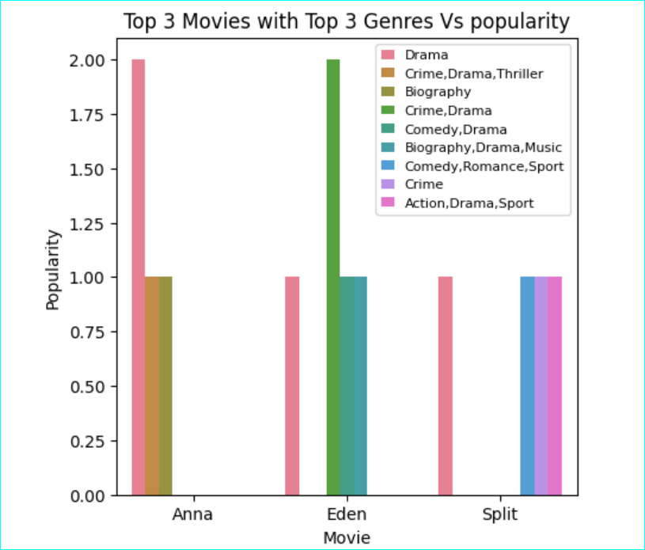
VISUAL
Notes:
Fi 4:Dramas from Anna were the most popular as well as crim,drama,thriller from Eden Movies.

Slide 14
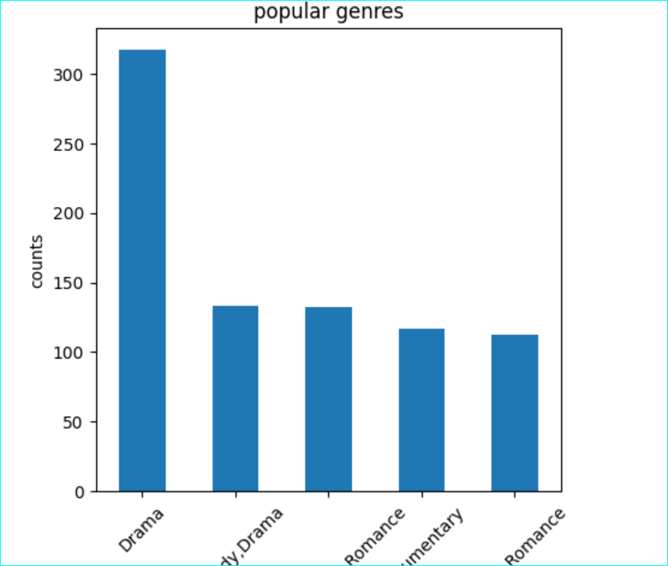
VISUAL
Notes:
Fig 5:Drama was the most popular genre doubling the other categories.

Slide 15
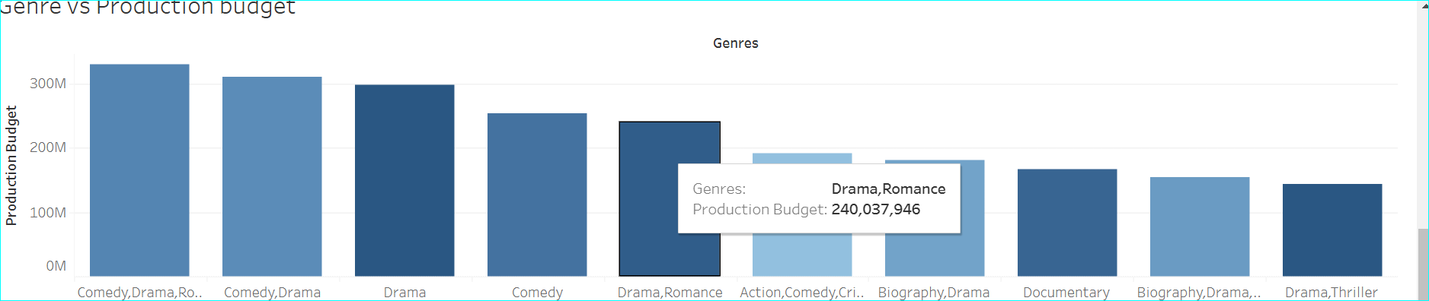
VISUAL TWO
Notes:
Fig 6:comedy ,drama were costly in budget but gave the highest retuns on investment.

Slide 16
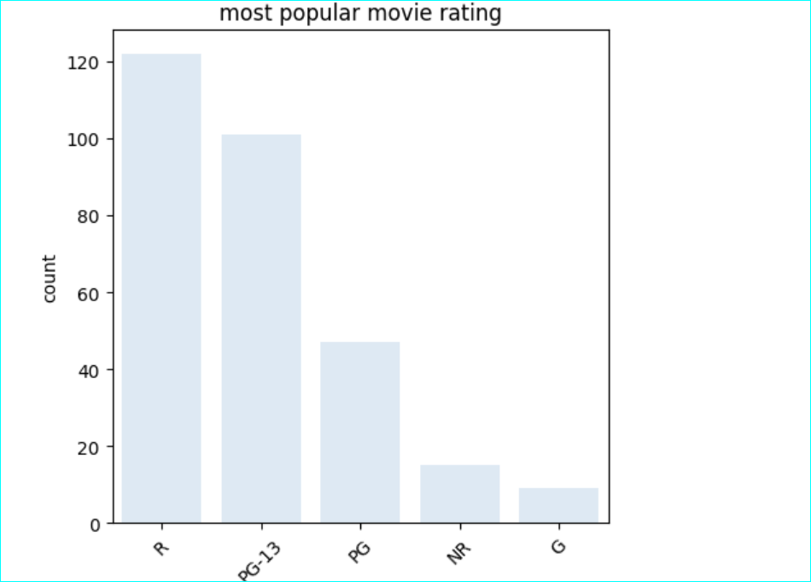
VISUAL
Notes:
Fig 7:R,PG-13,PG IN Descending order of popularity.

Slide 17
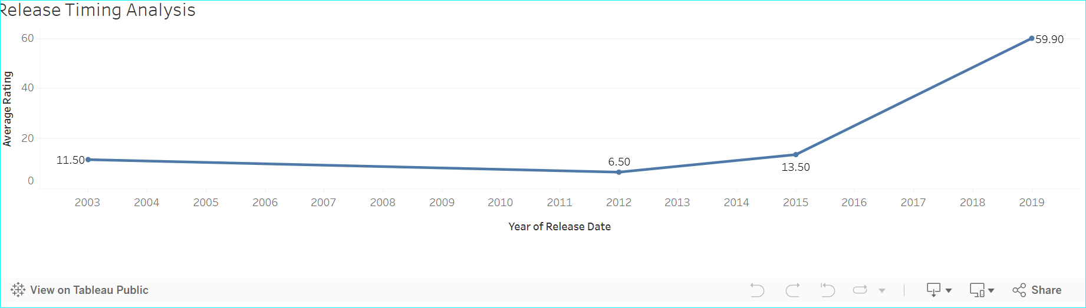
visual
Notes:
Fig 8:Time series showed an upward trend in terms of Rating.Worth investing.

Slide 18
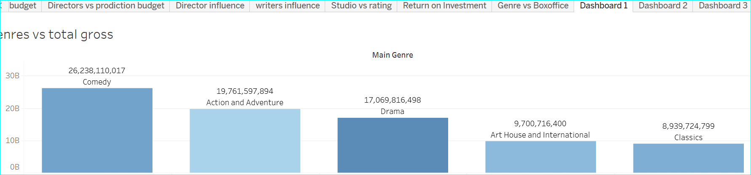
VISUAL ONE
Notes:
FIG 9:Drama,ACTION And Adventure,comedy showed an increasing trend in terms of gross profits.

Slide 19
RESULTS/FINDINGS
ROI Leaders: Action and Adventure genres lead in return on investment (ROI), making them highly profitable.
Budget Allocation: Production budgets are highest for Comedy and Drama, reflecting their revenue potential.
Studio Performance: Universal Pictures has the highest average ratings, showcasing its strong audience appeal.
Release Timing: Average ratings peaked in recent years, suggesting growing audience satisfaction with newer movies. ROI Leaders: Action and Adventure genres lead in return on investment (ROI), making them highly profitable.
Budget Allocation: Production budgets are highest for Comedy and Drama, reflecting their revenue potential.
Studio Performance: Universal Pictures has the highest average ratings, showcasing its strong audience appeal.
Release Timing: Average ratings peaked in recent years, suggesting growing audience satisfaction with newer movies.

Slide 20
ACKNOWLEDGEMENT
We would like to acknowledge all the group one members for working tirelessly to contribute to this project:
We would also like to pass our regard tour technical mentor MR.William Okomba having shaped our journey of learning data science.
All our cousemates who have been helping us to debug and unblog whenever in need.

Slide 21
CONCLUSION
Revenue Drivers: Comedy and Action genres generate the highest total box office revenues, with Comedy grossing over $262 billion and Action and Adventure closely following.
Director Influence: Directors like Clint Eastwood and Steven Spielberg consistently produce movies with high average ratings.
Writer Impact: Writers like Woody Allen and Jim Jarmusch are associated with above-average ratings. ROI Leaders: Action and Adventure genres lead in return on investment (ROI), making them highly profitable.
Budget Allocation: Production budgets are highest for Comedy and Drama, reflecting their revenue potential.
Studio Performance: Universal Pictures has the highest average ratings, showcasing its strong audience appeal.
Release Timing: Average ratings peaked in recent years, suggesting growing audience satisfaction with newer movies.

Slide 22
HYPOTHESIS TESTING REPORT
1.Testing the nature of the data
2.Setting confidence interval
3.Checking on the stas of the runtime
4.Stating the Null and alternative hypothesis

Slide 23
MODELING REPORT
1] R² is computed without centering (uncentered) since the model does not contain a constant.
[2] Standard Errors assume that the covariance matrix of the errors is correctly specified. [3] The condition number is large, 1.74e+04. This might indicate that there are strong multicollinearity or other numerical problems.

Slide 24
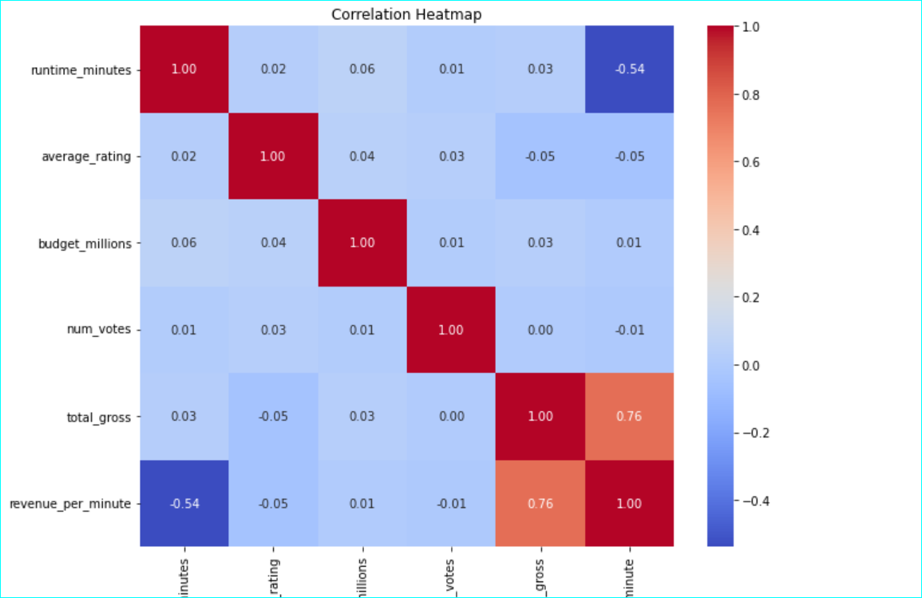
MODELING AND EVALUATION
Notes:
FIG 10:CORRELLATION HEATMAP

Slide 25
RECCOMMENDATIONS
Prioritize Action and Comedy genres for future productions, as they have proven to be the most lucrative and widely appreciated.
Partner with top-rated directors (e.g., Steven Spielberg, Clint Eastwood) and writers (e.g., Woody Allen) to enhance critical and audience reception.
Optimize movie runtimes based on audience preferences; longer runtimes for Action and Adventure, and shorter runtimes for genres like Animation.
Leverage Universal Pictures for distribution due to their strong track record in generating high ratings.

Slide 26
DATA PREPROCCESSING REPORT

Slide 27
CONTACT INFORMATION
catherine.kiptui@student.moringaschool.com
michellekavetza@gmail.com
gateromichael@gmail.com
4.noordinoordino470@gmail.com
5. kennethnyangweso99@gmail.com
6. aumakrystel5@gmail.com
7.segomich227@gmail.com

